Slide 1
2026 TB Hackathon
Adverse Event (AE) Visualizations Code Demonstration Presented by Mark Warden, PhD

Slide 2

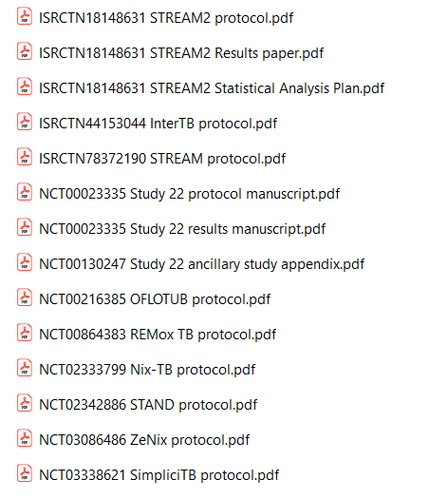

BACKGROUND
The TB-PACTS data:

Slide 3
Making TB-PACTS Code Repository:
BACKGROUND
We hope that you choose to share code you create today (that creates datasets, figures, etc.), so that the TB-Pacts code repository becomes more useful for all researchers who use it in the future!
Please save any figures or analyses you produce and share them in the slack! We will curate and add them to the repo!

Slide 4
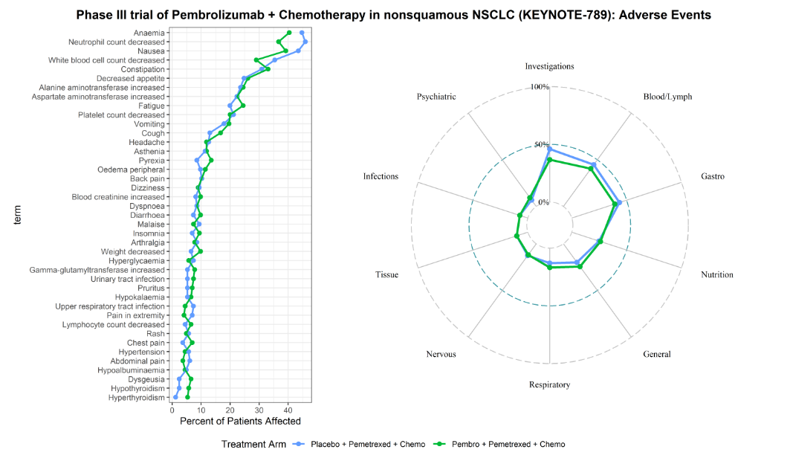
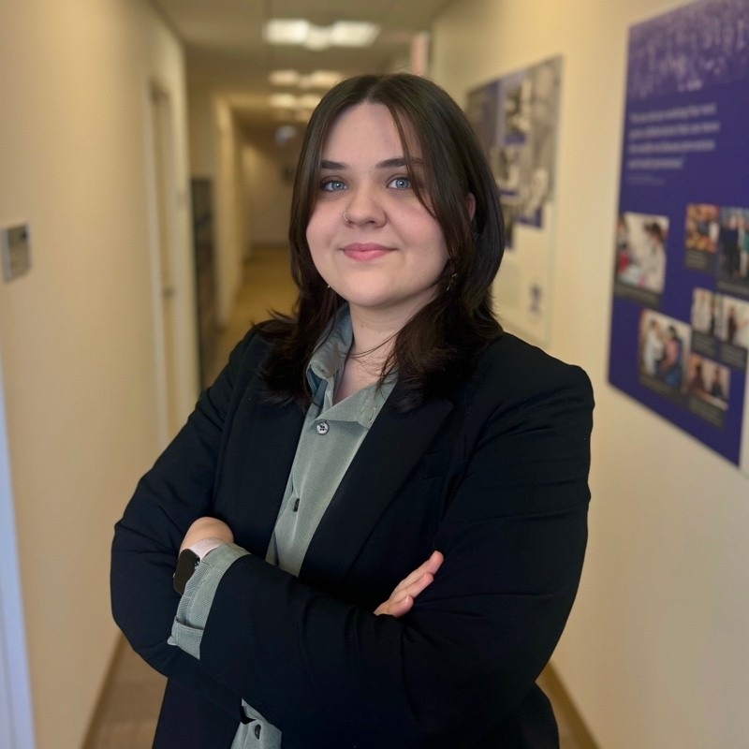

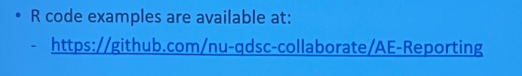
BACKGROUND
Graphical visualizations of AEs
Presented by Katrina Dobinda, MS

Slide 5
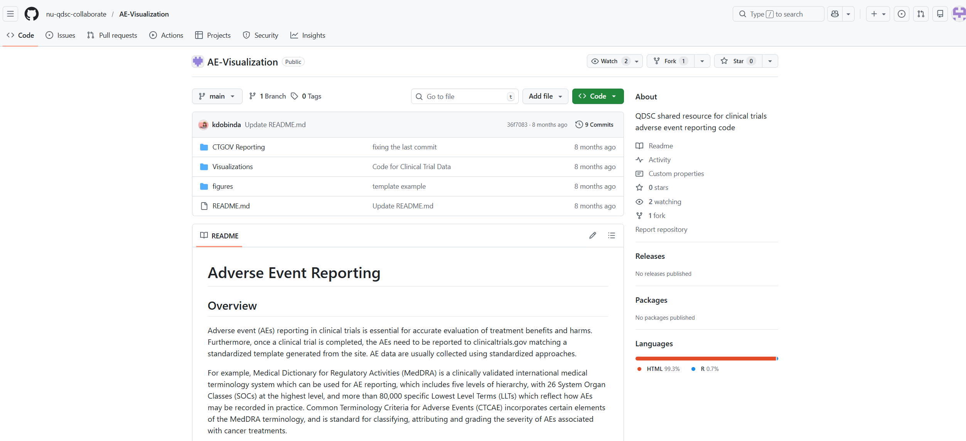
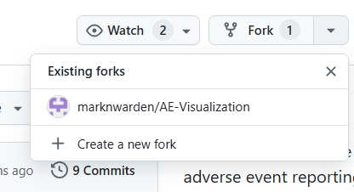




BACKGROND
Presented by Katrina Dobinda, MS

Slide 6
Now, over to R studio!!!

